Slide 1
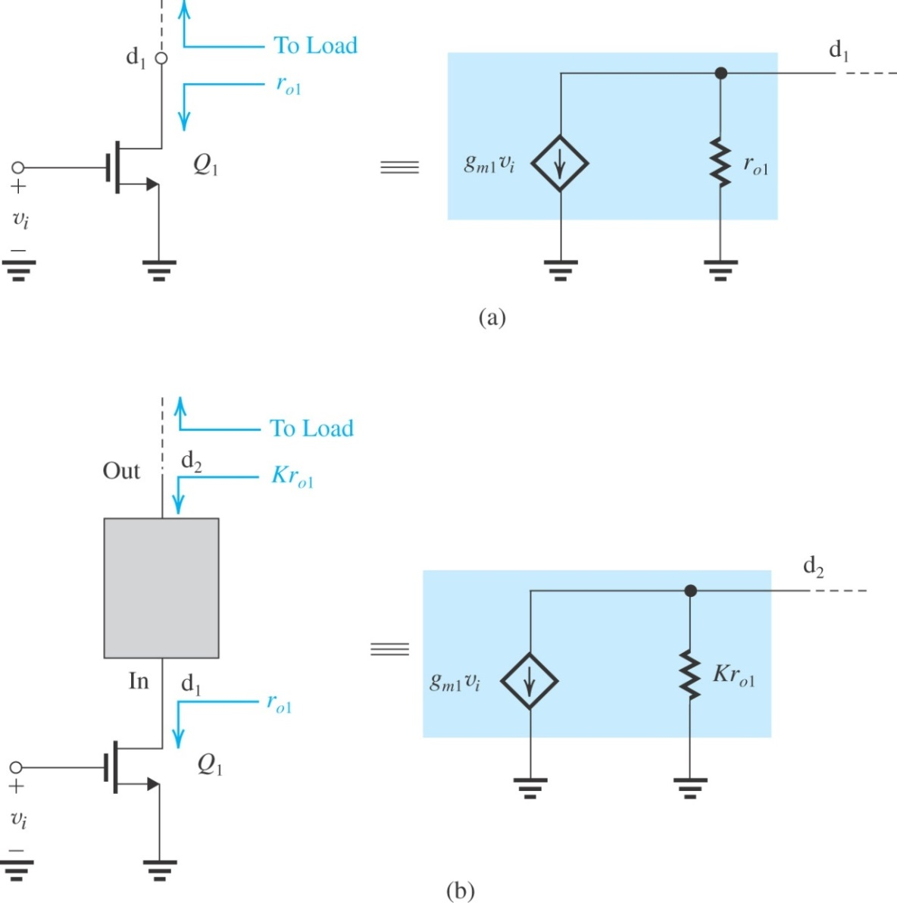

Increasing the Gain of the Basic Cell
Q: How can we increase the voltage gain obtained from basic gain cell?
A: Find a way to raise the level of output resistance of the gain cell. The gain is proportional to the resistance at the output
A: Seek a circuit that passes the current g_{m}v_{i} provided by the amplifying transistor right through, but increases the resistance from r_{o} to a much larger value.
The only candidate is CG or CB amplifier
Figure: To increase the voltage gain realized in the basic gain cell shown in (a), a functional block, shown as a black box in (b), is connected between d₁ and the load.

Slide 2

Increasing the Gain of the Basic Cell
The black box of Figure is a current buffer
Two important observations should be made:
It is not sufficient to raise output resistance of amplifying transistor only.
Placing CG (or a CB) circuit on top of the CS (or CE) amplifying transistor to implement the current-buffering action is called cascading.

Slide 3
The Cascode Amplifier
The MOS cascode
Cascoding refers to the use of the transistor connected in the common-gate (or common-base) configuration.
Provides current buffering for the output of a common-source (or common-emitter) amplifying transistor.
Figure in the next slide illustrates this technique for MOS case.

Slide 4
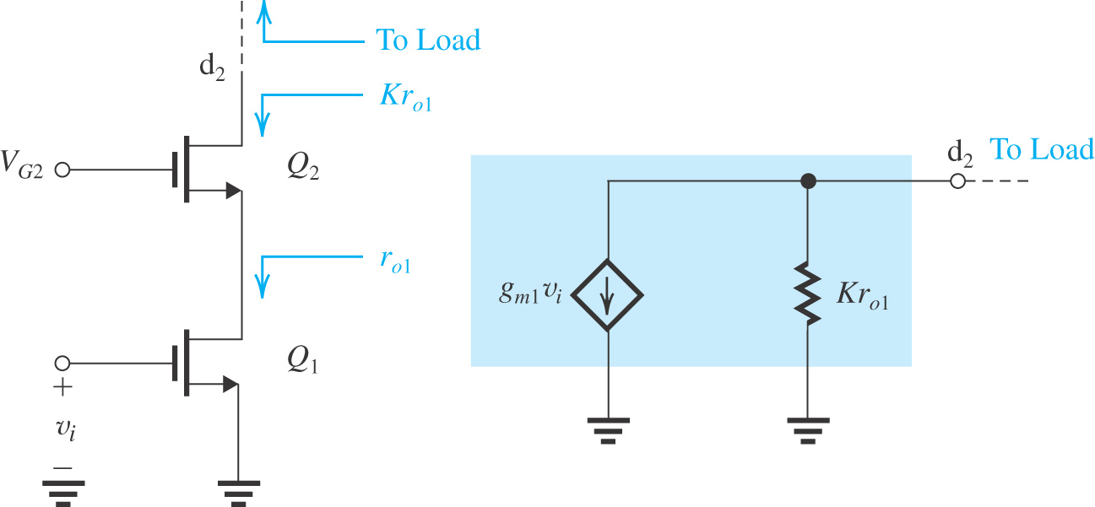
The Cascode Amplifier
Circuit topology:
Putting a CG (Q₂:cascode transistor ≡ current-buffering action is implemented using a transistor Q₂ ) on top of CS (Q₁:amplifying transistor). Here V_{G2} is the dc bias voltage.
The cascode transistor passes the small-signal current g_{m1}v_{i} to the output node while raising the resistance level by a factor of K

Slide 5
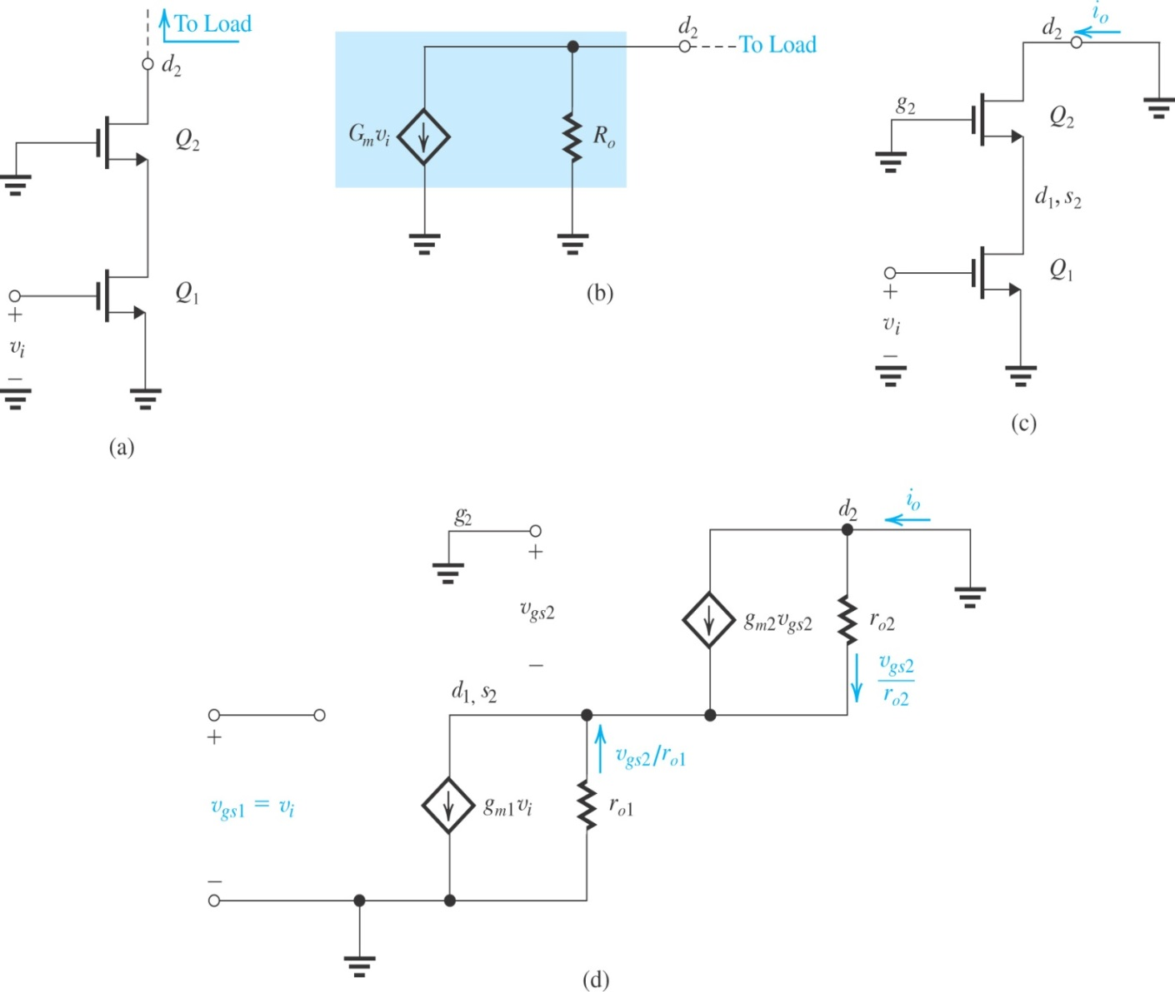
The MOS Cascode
Figure: (a) A MOS cascode amplifier prepared for small-signal calculations; (b) output equivalent circuit of the amplifier in (a); (c) the cascode amplifier with the output short-circuited to determine G_{m}; (d) equivalent circuit of the situation in (c).
Figure shows the MOS cascode amplifier without a load circuit and with the gate of Q₂ connected to signal ground.
This circuit is valid for small-signal calculations only.
Objective is to determine the parameters g_{m} and R_{O} of the equivalent circuit shown in Fig (b).
If the node d₂ of the equivalent circuit is short-circuited to ground, the current flowing through the short-circuit will equal G_{m}v_{i}.
Note that G_{m} = i_{o}/v_{i}.

Slide 6
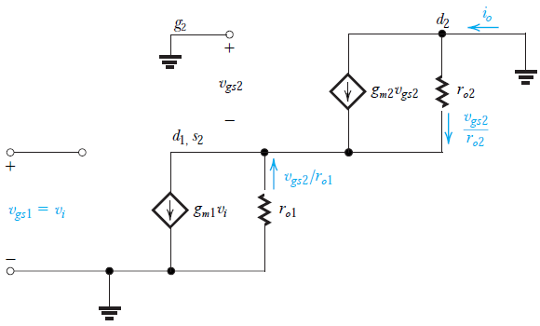
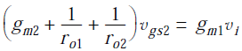
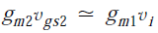
The MOS Cascode
Observe that the voltage at the (d₁, s₂) node is equal to –v_{gs2}. Writing a node equation for that node, we have
The current of the controlled source of Q₂ is equal to that of the controlled source of Q₁
@ d₂ node:
Thus:

Slide 7
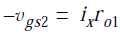
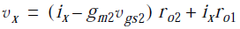
The MOS Cascode
@ the source node of Q₂
v_{x} is the sum of the voltages across r_{o2} & r_{o1} as
The CG transistor Q₂ raises the output resistance of the amplifier by the factor g_{m2}r_{o2}
At the same time, Q₂ simply passes the current g_{m1}v_{i} to the output node.
Thus the CG or cascode transistor very effectively realizes the objectives we set for the current buffer with
K = A_{o2} = g_{m2}r_{o2}
Figure: Determining the output resistance of the MOS cascode amplifier.

Slide 8
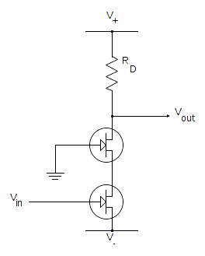
Quiz 2.3
Two NMOS FETs Q1 and Q2 are depicted in the Figure. The current I_{D} = 0.5mA for both transistors, and V_{GS} – V_{t} = 1V for Q1 and Q2. The value R_{D} = 4kΩ and V_{A} = 100V for Q1 and Q2.
What is the name of this circuit?
Determine r_{o1} and r_{o2}.
Plot small signal equivalent circuit. Compute G_{m} and R_{o}.
Determine voltage gain v_{o}/v_{i}.
Positive voltage
Q2
D
S
Q1
D
S
Negative voltage
You submit your solution not later than March 20, 2020.
You can submit through Blackboard as informed by Mr. Huy on Blackboard announcement.

